Slide 1
Applications of Information and Communication Technologies
Rabail Asghar
Lecturer (Computer Science)
COMSATS University Islamabad, Lahore Campus

Slide 2
Topics to cover
Control Flow Statements

Slide 3
Control Flow Statements
The statements inside your source files are generally executed from top to bottom, in the order that they appear. Control flow statements, however, break up the flow of execution by employing decision making/conditioning, looping, and transferring control, enabling your program to execute particular blocks of code.

Slide 4
Control Flow Statements
The control flow statements are divided into three parts:-
Conditional statements
Iterative statements
Transfer statements

Slide 5
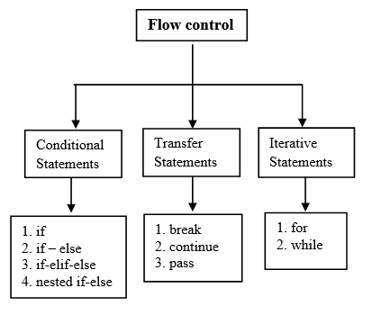
Control Flow Statements

Slide 6
Iterative statements
The iterative statements are also known as looping statements or repetitive statements. The iterative statements are used to execute a part of the program repeatedly as long as a given condition is True.
1)while loop
2) for loop

Slide 7
while loop
The while loop in Python is a control structure that allows code to be executed repeatedly as long as a certain condition is true.
It is typically used when the number of iterations is not known in advance.

Slide 8
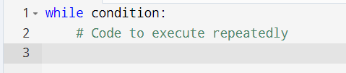
while loop

Slide 9
while loop
The condition is evaluated before the loop body executes. If the condition is True, the loop body runs.
After each execution of the loop body, the condition is checked again. If it's still True, the loop runs again.
The loop will stop running when the condition becomes False.

Slide 10

Example: printing 1 to 5

Slide 11
While loop
Explanation
The loop runs as long as count is less than or equal to 5.
Each time the loop runs, it prints the current value of count and then increases count by 1(You manage the counter yourself and control when to stop).

Slide 12
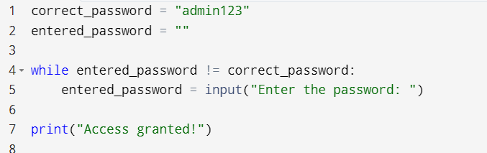
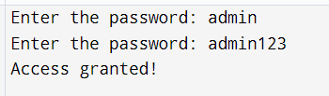
Example: Password Checker

Slide 13
for loop
A for loop in Python is used to iterate over a sequence of items (like a list, string, or range) and execute a block of code for each item in the sequence.
It is typically used when the number of iterations is known or when working with items in a collection.

Slide 14
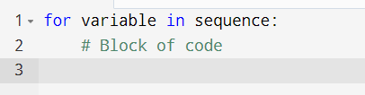
for loop
variable: The loop variable that takes the value of each item in the sequence.
sequence: The sequence of elements you want to iterate over (e.g., a list, string, range or any other iterable object).
The loop will continue to run once for each item in the sequence.

Slide 15
Example
Iterating Over a List of Products
Let's say you have a list of products in your inventory, and you want to print each product's name:

Slide 16
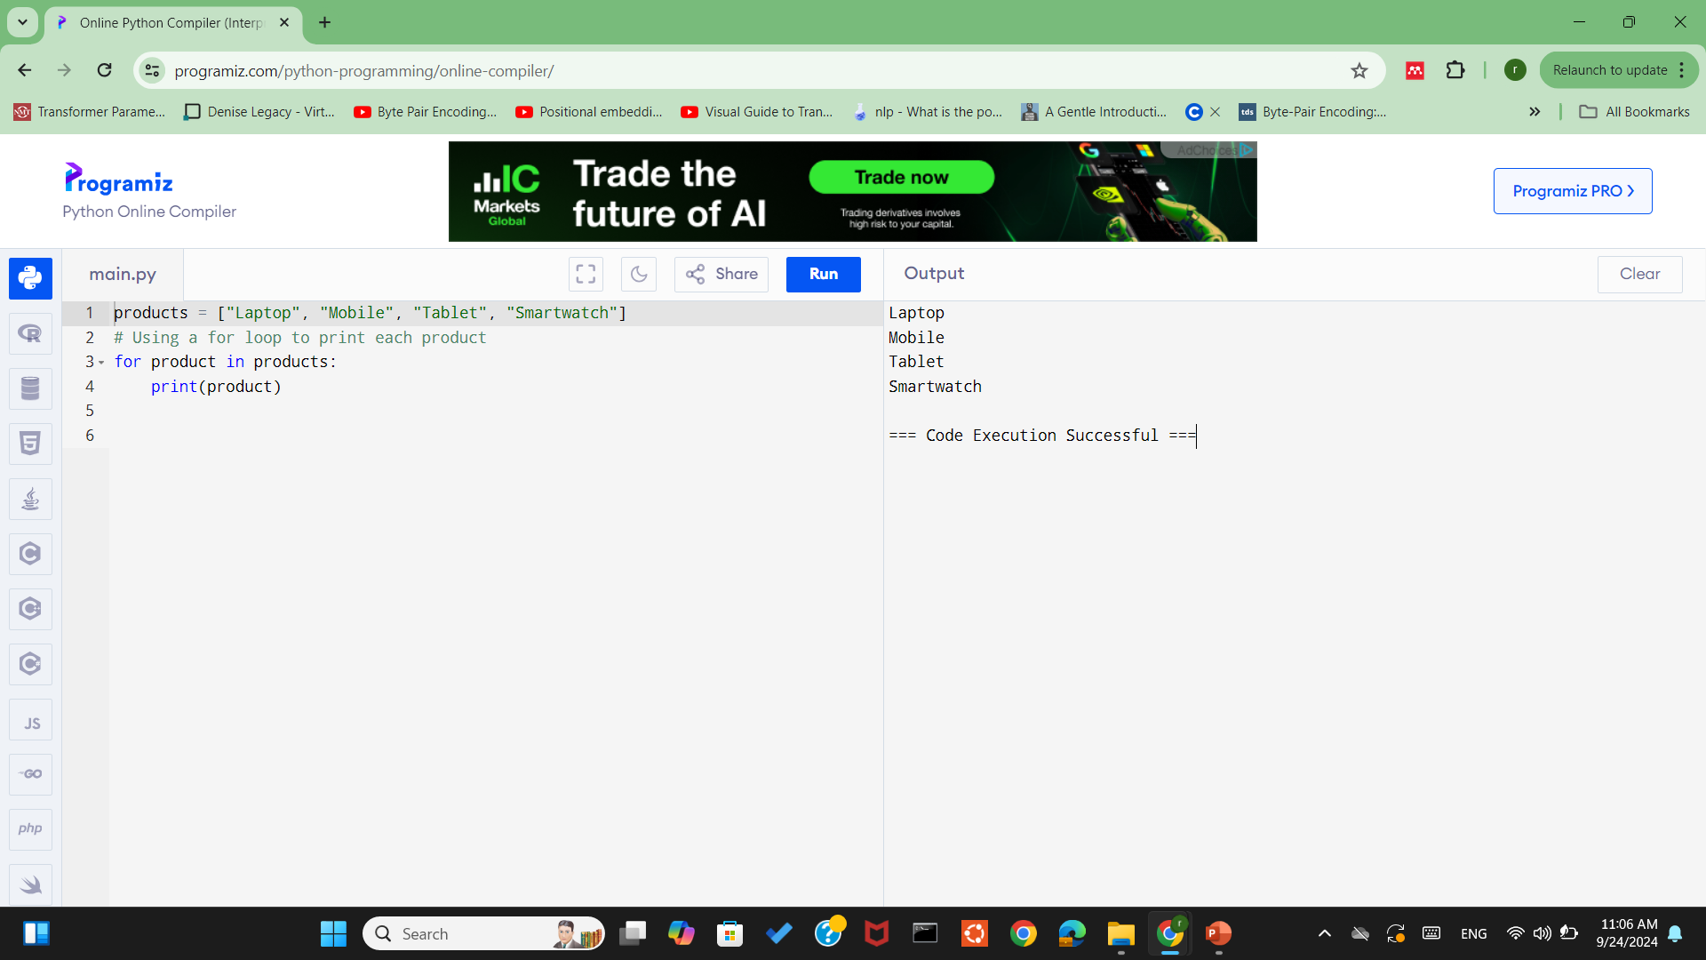
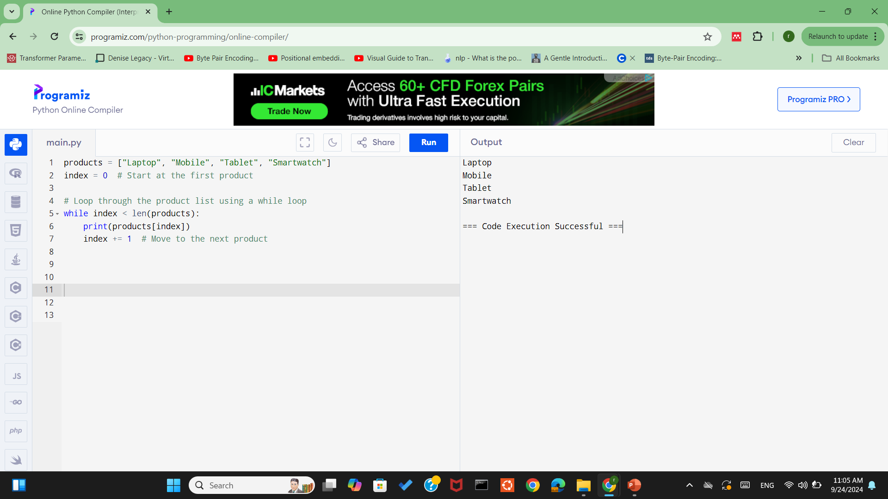
Using for loop

Slide 17
Using for loop
Here, the for loop goes through each item in the products list. The variable product takes the value of each item one by one, and the print statement outputs the product names.

Slide 18
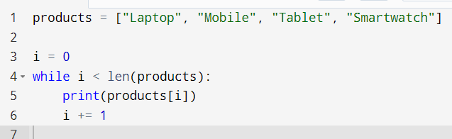
Using while loop

Slide 19
Explanation:
i starts at 0 (the first index).
len(products) gives the total number of items.
we manually access each item using products[i] and then increase i.

Slide 20
Why for loop instead of while loop?
It is typically used when the number of iterations is known or when working with items in a collection.
For loop is shorter, cleaner when looping over known ranges or sequences.
Don’t have to manually update a counter or check conditions.
It reads more like plain English: "for each item in this list..."

Slide 21
Range()
The range() function is particularly useful when you want to repeat a set of instructions a specific number of times.

Slide 22
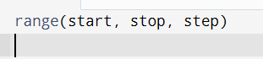
syntax
start: The number, the sequence starts from. (optional, default is 0).
stop: The number the sequence stops before. (not inclusive and is compulsory).
step: the increment (default is 1)

Slide 23
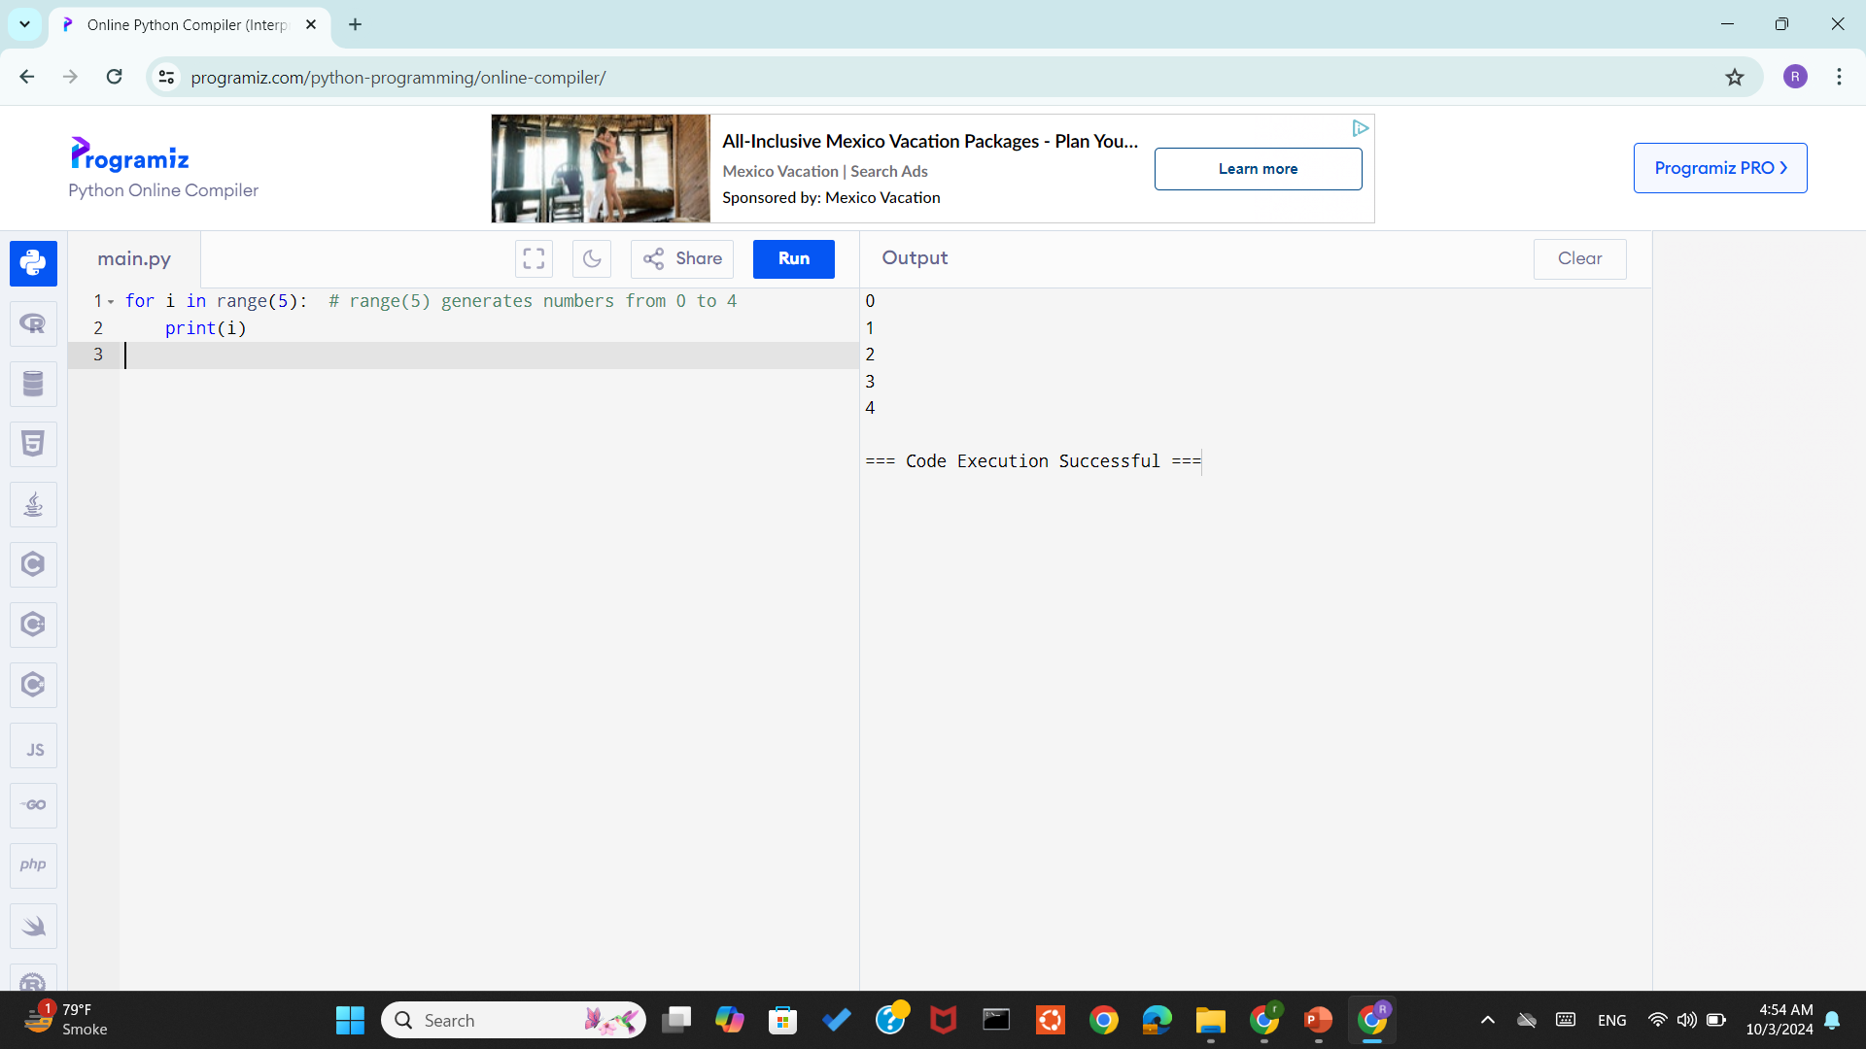
Example print numbers from 0 to 4 using range():

Slide 24
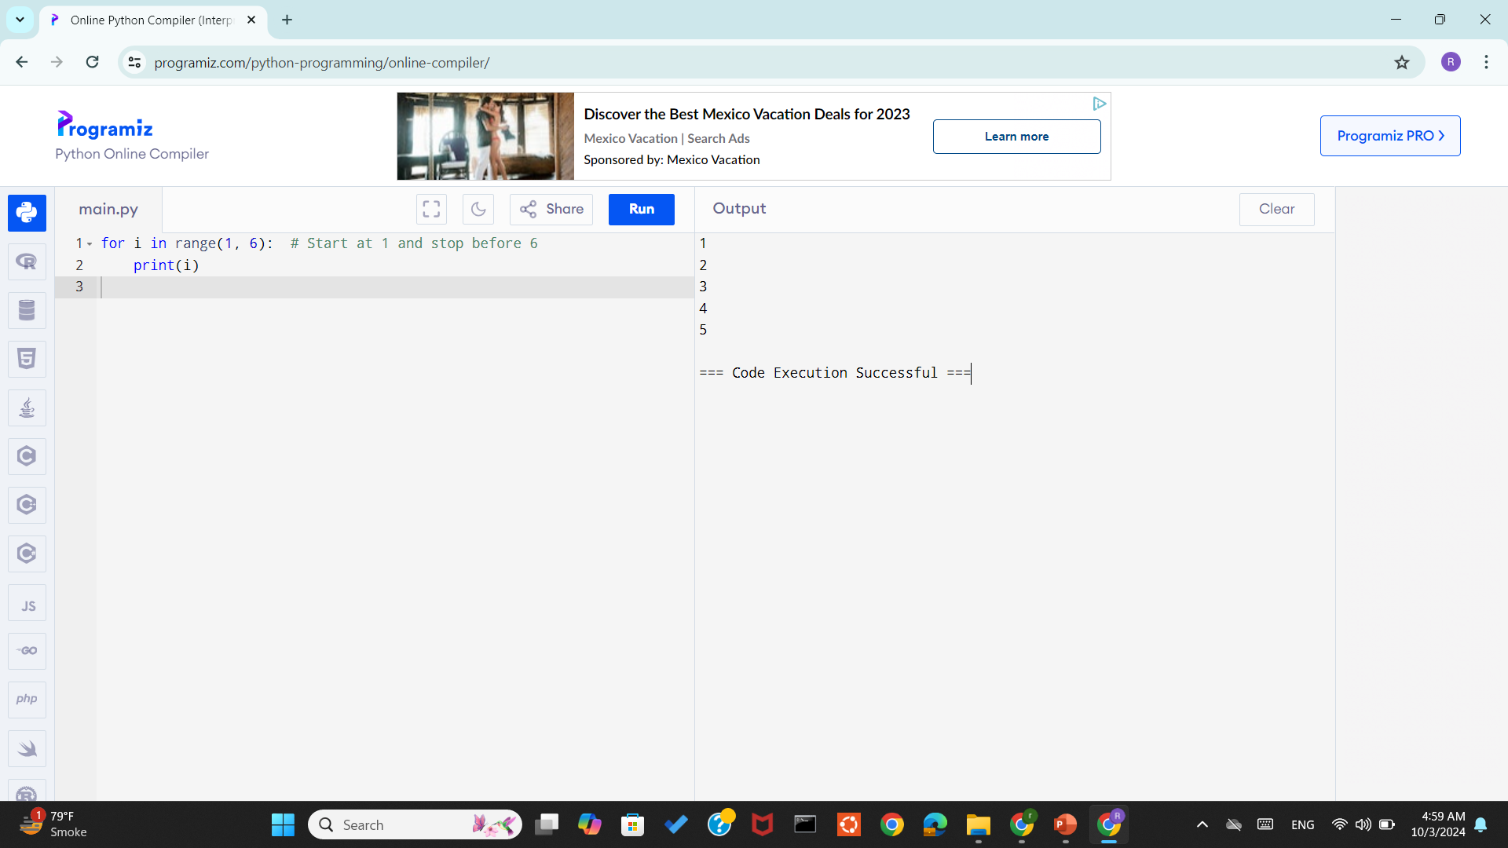
Range()
Specifying a Starting Point
In this case, range(1, 6) generates numbers starting at 1 and ending before 6.

Slide 25

Range()
Using a Step Value
we can include a step value to control the increment between each number.
Example to print even numbers between 0 and 10:
Here, range(0, 11, 2) generates numbers starting at 0, ending before 11, and counting by 2.
Example: checking stock levels every 2 days

Slide 26

Range()
Using for Loop with range() in Reverse
We can also use the range() function to count downwards by specifying a negative step value. Here’s how we can count backward from 5 to 1:
Example to print backwards:
Example:counting down the days left until a business launch.

Slide 27
Tracking Customer Orders-using for loop
Your business tracks the number of orders placed over the first 7 days of a new product launch. Every day, the number of orders increases by 10 starting from 50.
Scenario: As a business analyst, you are tracking the number of customer orders for a new product launch over the first week.

Slide 28
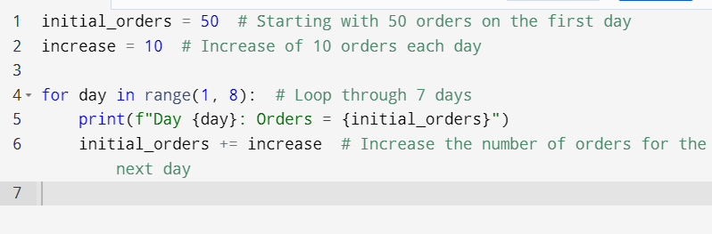
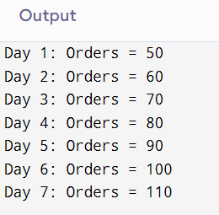

Slide 29
Tracking Customer Orders-using while loop
Do it yourself!

Slide 30
Input()
The input() function in Python is used to take input from the user.
The input is always treated as a string, so if you're expecting a number, you need to convert the input to the appropriate data type using int() for integers or float() for decimal numbers.

Slide 31

Syntax

Slide 32
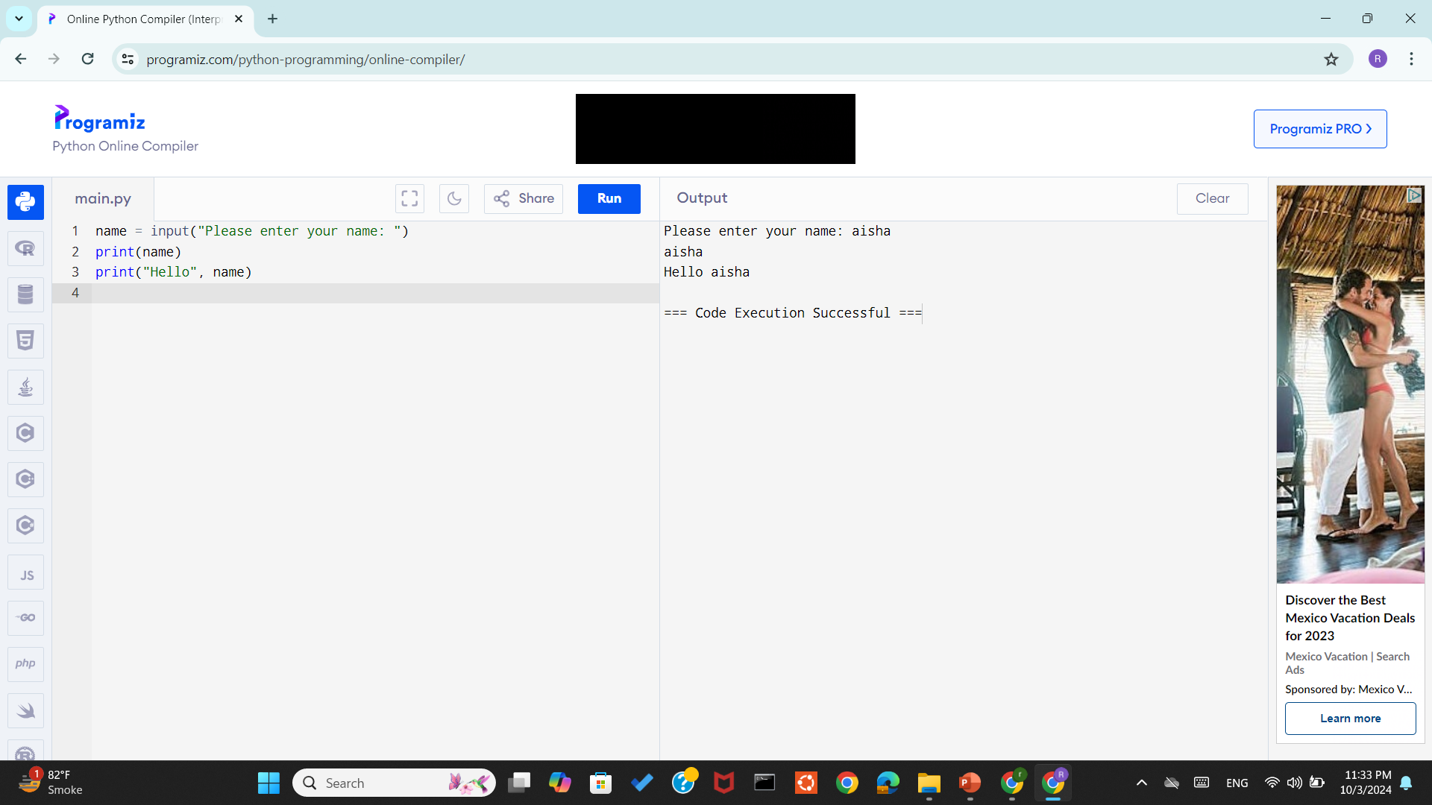
Example
Ask user for his/her name

Slide 33
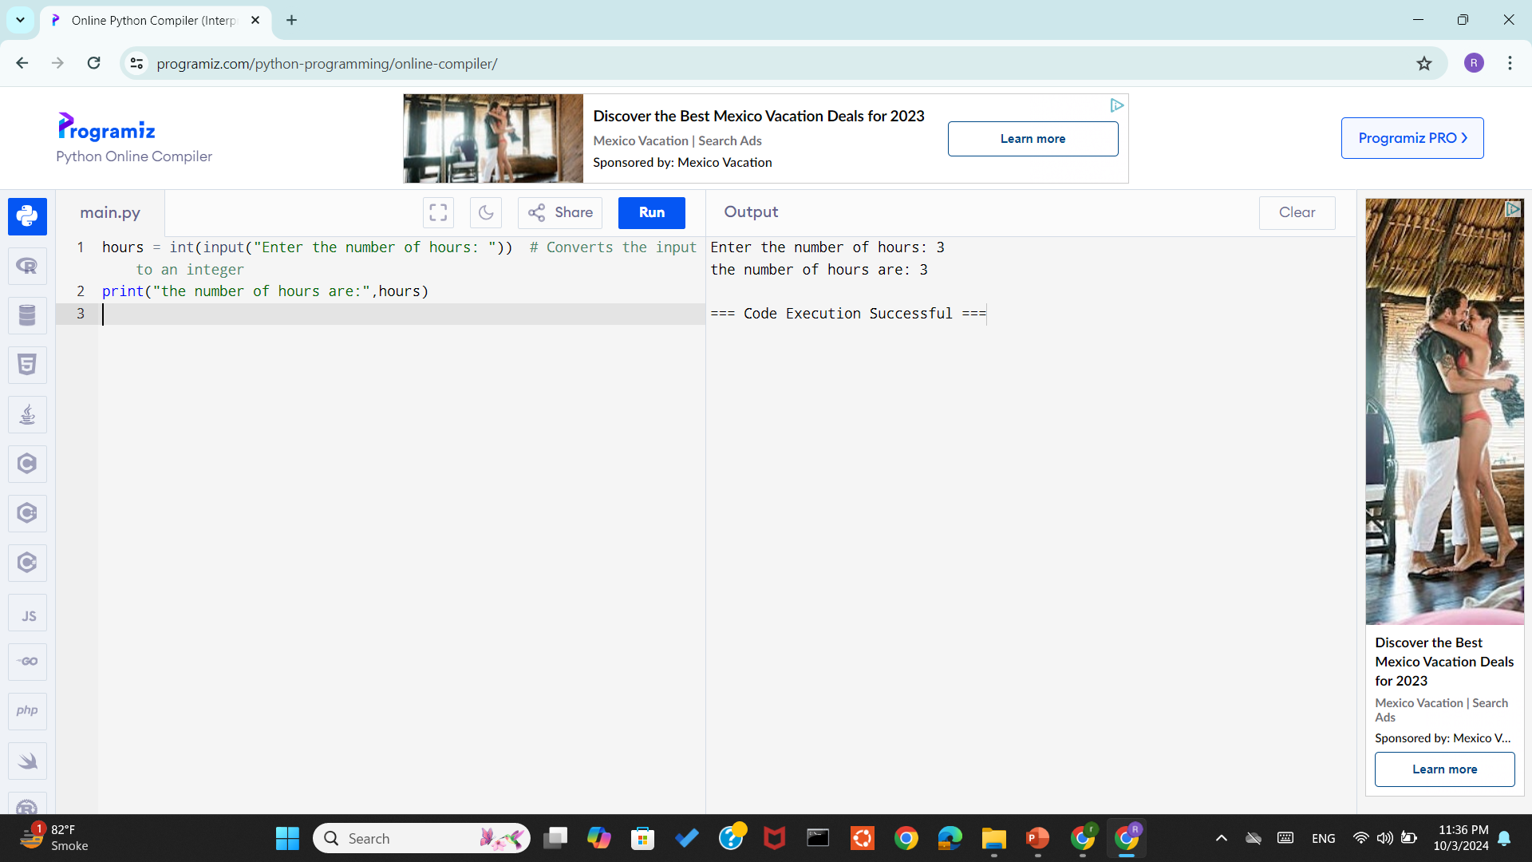
Example
Ask for integer input

Slide 34
Taking Boolean as Input using eval() function
eval() function is used to directly evaluates the input
The input "True" will be automatically converted to the boolean value True, and "False" will become False.

Slide 35
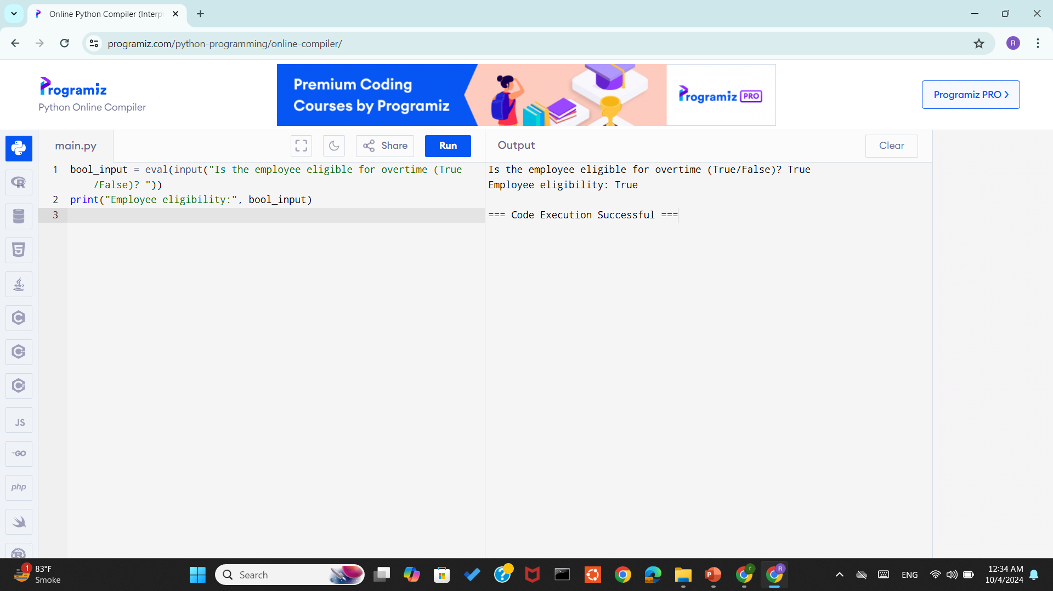
Taking Boolean as Input using eval() function

Slide 36
Example Can use either while loop or for loop to solve
Grocery List Entry
Scenario: Ask the user how many grocery items they want to enter. Then take that many item names and store them in a list.

Slide 37
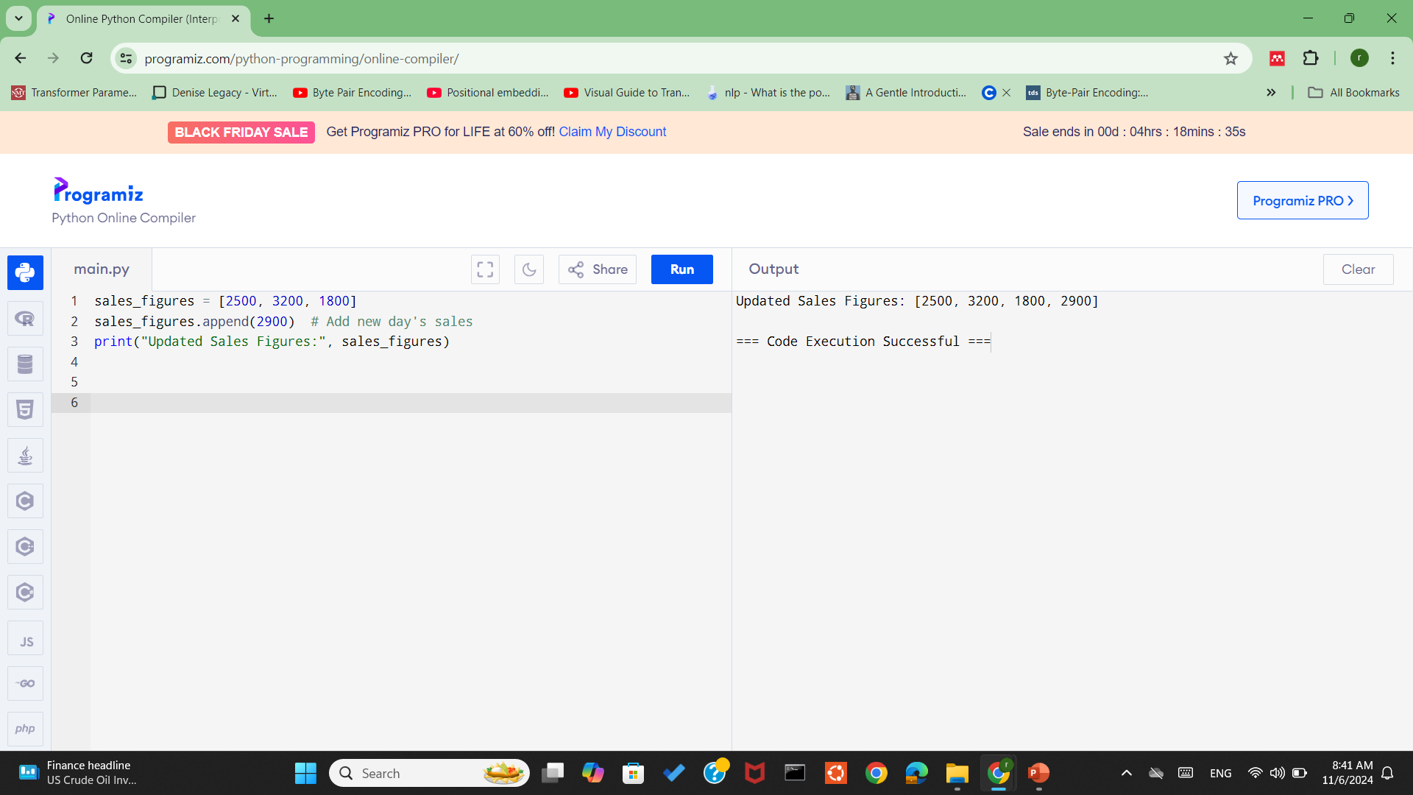
append()- Add an Item to a List
Used to add an item to the end of the list, which is helpful for continuously collecting or updating data.

Slide 38
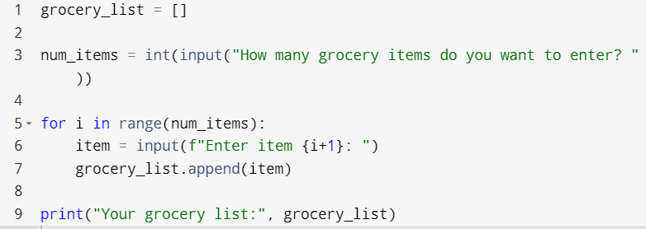
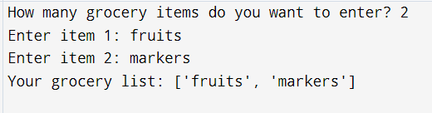

Slide 39
Example Can use either while loop or for loop to solve
Student Attendance Counter
Scenario: Ask for the total number of students. Then for each student, ask "Present or Absent?" and count how many are present.
Do it yourself!

Slide 40
Example Can use either while loop or for loop to solve
Age Group Categorizer
Problem: Ask the user to enter the ages of 5 people. For each person, classify them into one of these categories:
Child (age < 13)
Teenager (13 ≤ age < 20)
Adult (20 ≤ age < 60)
Senior (age ≥ 60)
At the end, show how many people belong to each category.

Slide 41
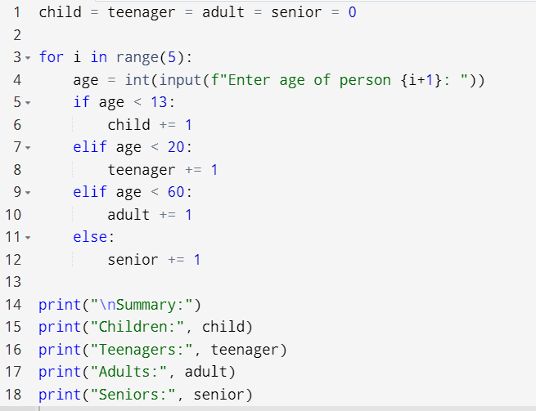
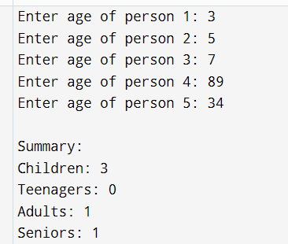

Slide 42
Example Can use either while loop or for loop to solve
Shopping Discount Calculator
Problem: Let a user enter the price of 5 products. For each product:
If price > 1000, apply a 10% discount
If 500 ≤ price ≤ 1000, apply a 5% discount
Else, no discount
Print the final price of each product and the total amount saved.
Do it yourself!
Notes:
discount = price * discount_rate
final_price = price - discount

Slide 43
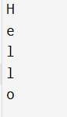
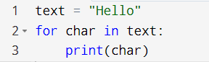
for loop for string
A string is a sequence of characters.
A for loop can be used to iterate over each character in a string.
Basic Example:

Slide 44
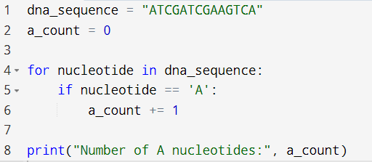
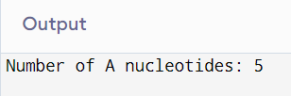
Example: Counting Gene Codes in a DNA Sequence
Suppose you are analyzing a DNA string in a bioinformatics project. You want to count how many times a specific nucleotide (like 'A') appears in the DNA sequence.

Slide 45
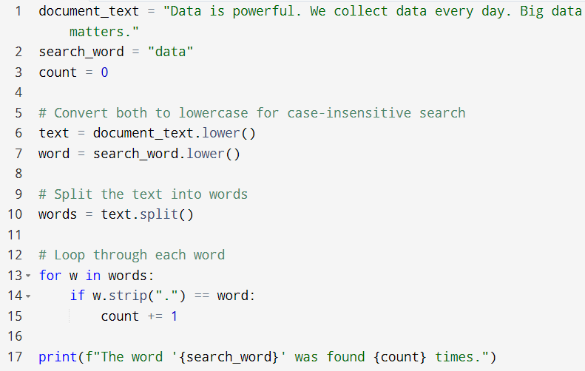
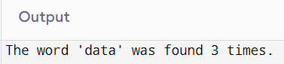
Example: Search a Word in Text (Like MS Word)

Slide 46
Explanation
document_text contains the text we want to search in — like content from an MS Word document.
search_word is the word we want to find (like using Ctrl + F in Word).
count = 0 initializes a counter to keep track of how many times the word is found.
text.lower() and search_word.lower() Converts both the document and the search word to lowercase so the search is case-insensitive (e.g., “Data” matches “data”).
text.split() Splits the sentence into a list of words using spaces. Example: "we collect data." becomes ["we", "collect", "data."]..(a list)

Slide 47
Explanation
for w in words: Loops through each word in the list.
w.strip(".") Removes the period from the end of a word like "data.", making it "data" so it can match correctly.
if w.strip(".") == word: Compares the cleaned word with the search word.
count += 1 If a match is found, it increases the count.
print(...) Finally, it prints how many times the word was found in the document.

